Slide 1
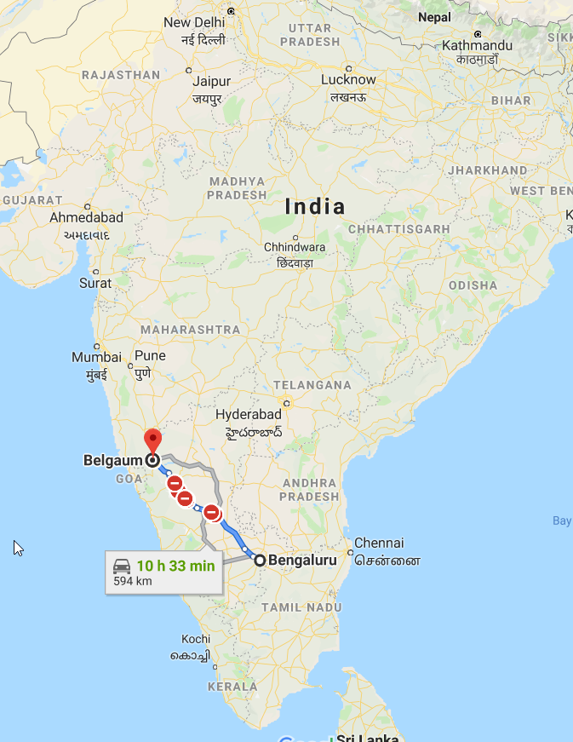
PROPOSAL FOR North Karnataka Flood rehabilitation Submitted to HSS NOrway
www.sewainternational.org

Slide 2
PROPOSED REHABILITATION IN SCHOOLS Schools
SL | School Name | District | Taluk | Girls Count | Boys Count | Total | Estimation in Rs | Remarks
1 | Government Kannada Higher Primary School , Kesappanahatti | Belgaum | Gokak | 76 | 32 | 108 | 126,000 | Ceiling repair for 4 classrooms. Painting for 4 classrooms. Repair of 2 Toilets and 4 Urinals. Procurement of 6 Tables, 12 Chairs. Water Tank, Plumbing work. 1 Computer requirement
2 | Government Kannada Primary School, Lagmeshwar | Belgaum | Gokak | 68 | 42 | 110 | 80,000 | 1 New Toilet installation. 2 Urinals installation. Plumbing work at school (use the existing water tank if possible else installation of new water tank ). Procurement of 2 Table, 6 Chairs. Painting for 3 classrooms.
 | Grand Total |  |  |  |  | 218 | 206,000
GOVERNMENT Schools flood impacted list
In the above villages, recent floods have impacted the schools - school compound wall, classrooms and toilets
The above estimation is indicative in nature and subject to change based on the detailed review

Slide 3
GOVERNMENT KANNADA HIGHER PRIMARY SCHOOL, KESAPPANAHATTI

Slide 4
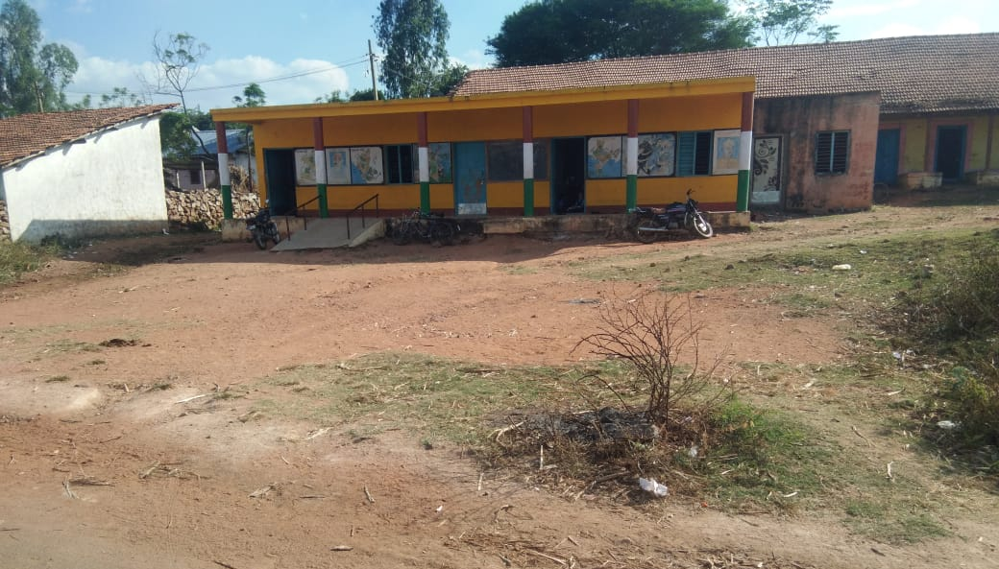
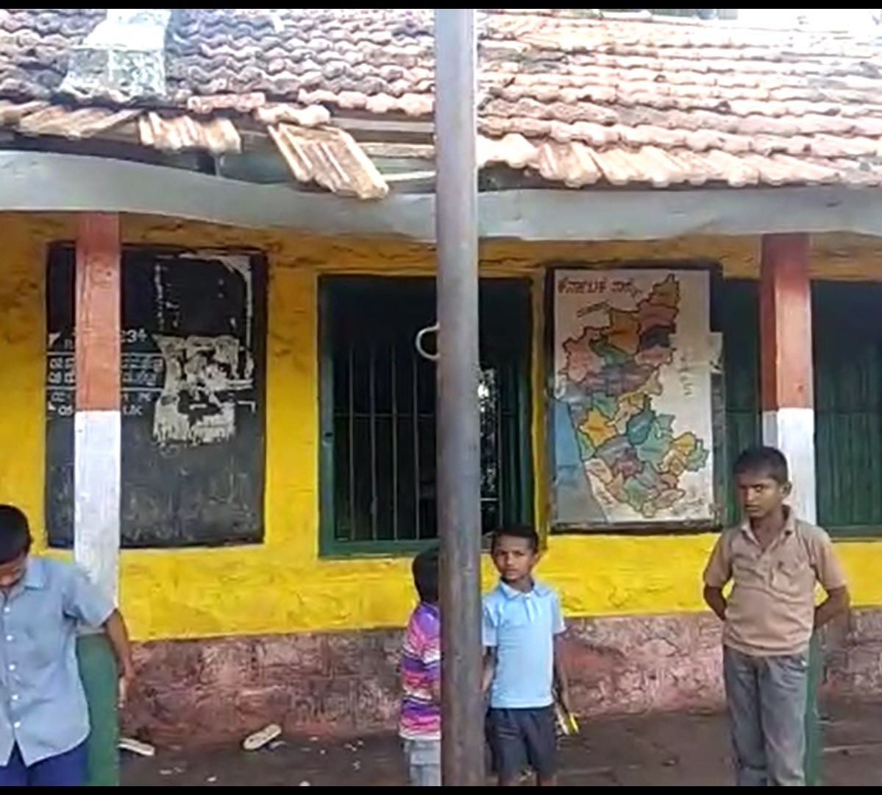
GOVERNMENT Kannada Primary School, LagmeshwaR

Slide 5
Implementation methodlogy
Conduct Survey
Identify Flood hit Areas
Online Survey App
Engage / Employ Local People
Local connections
School CRPs
Involving Village Panchayat and PDO
Design & Planning
Documents from School and Govt officials
Define standard Design for ease of rollout
Hire construction labor (local and from nearby Taluk)
Implementation
Roll out construction / Finishing
Quality check and verification
Handover
Track, Report & Maintain
Photos and videos
Online Status report
New letters / Media
Maintenance Services
Quickly Data capture
Transpertant solution
Documentation
Donor online access to status

Slide 6
SEWA international has built 40 toilets in in north Karnataka belgaum, Hubli & GOKAK
https://www.youtube.com/watch?v=7kXRSQhcb9I&t=11s
We have a dedicated team in
Belgaum for Rehab
Support for flood impacted Schools.
Email: toilets@sewausa.org

Slide 7
Contact Us
Nishant Aggarwal (CEO)- Email: nishant@sewainternational.org, Mob : 9910550176,
Phagun Adhupiya (Program Manager)- Email : pm-projects@sewainternational.org, Mob : 8851292355,
Admin/Office, Tel: +91-11-43007650, contact@sewainternational.org
Correspondence Address: 35/13, Second Floor, Krishan Lal Bhatia Marg, East Patel Nagar, New Delhi – 110008
Regd. Address : Plot No. 49, Deen Dayal Upadhyaya Marg, New Delhi – 110002

